Slide 1
Self-Advocacy
Kristin Williams
LDT-C
April 20, 2023

Slide 2
What does Self-advocacy mean?
An individual’s ability to effectively communicate, convey, negotiate, or assert his or her interests, desires, needs and rights. (VanReusen et al., 1994)
Self-Advocacy is learning to speak up for yourself, make your own decisions about your life, learn how to get information so that you can understand, finding the supports around you, knowing your rights and responsibilities, problem-solving, listening, reaching out for help.

Slide 4
Why is self-advocacy important?
Students need the skills to be independent and make decisions about their own life.

Slide 5
What the research says about self-advocacy
Conceptual Framework:
-Knowledge of self (academic strengths/weaknesses)
-Knowledge of rights (Accommodations/services available)
-Communication (ability to request information, assistance, and accommodations).
-Leadership
-
A Conceptual Framework of Self-Advocacy for Students with Disabilities
Test, David W;Fowler, Catherine H;Wood, Wendy M;Brewer, Denise M;Eddy, Steven
Remedial and Special Education; Jan/Feb 2005; 26, 1; ProQuest Central
pg. 43

Slide 6
Knowledge of Self
-Skills/Abilities
-Hobbies/Interests
-Life and Career Dreams
-Knowledge of Disability
-Specific Challenges (processing, listening, reading, writing, focus)
-Ways you Learn Best (learning style)
-Develop Self-Confidence: OWN YOUR WHOLE SELF

Slide 7
Knowledge of rights
Attend IEP meetings
Get to know your case manager and how to access them
Know your accommodations/modifications
Understanding of basics of IEP: Annual Review, Triennial Reevaluation, Written Notice, Transition assistance
Set goals

Slide 8
Communication skills
-Learn assertive communication
-Body Language
-Listening and Compromise
-Identify/circle what is hard- ask for clarification
-Use email to get your thoughts out
-Role play- practice what you want to say
-Eye contact, state the accommodation and why you need it, thank the teacher
-Differentiate difficulty and disability

Slide 9
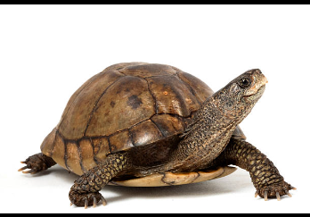
Types of communication
-Passive
-Aggressive
-Assertive

Slide 10
Self-Advocacy statements
-I need help.
-When can we talk or meet privately?
-I need to move.
-Can you give me 5 minutes and then come back?
-Can you explain that differently?
-Can you repeat that please?
-Can you clarify what you mean?
-I need ________ to learn.

Slide 11
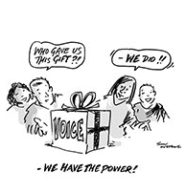
Parental role in supporting student self-advocacy
-Talk to your student
-Encourage them to attend meetings
-Suggest ways they can communicate with the teacher
-Let them productively struggle

Slide 12
What the students say
“When I realized what I was able to do and what I needed help with, I was able to advocate for myself.”- 9th grader
“For me, it is about making connections with my teachers. That is how I am able to feel comfortable advocating for myself.”- 9th grader
“I had to realize what I needed and say it and not be scared of the result. I don’t always know the outcome but learned to push back the fear. The worst that could happen was I get a no. Better to try to get what I need and at the very least the teacher knows I am struggling.”-12th grader

