Slide 1
Fifth Grade
Stakeholders’
Committee
December 13, 2023

Slide 2
Meeting Dates
December 13, 2023
January 18, 2024
February 1, 2024
February 15, 2024 (Make Up Date)
Location & Time
6:00 - 7:00 pm
Board of Education Building

Slide 3
Purpose of Committee
The charge of the committee is to:
Work collaboratively to review community concerns
Finalize recommendations to the Board of Education and administration on certain topics should the district reconfigure schools
The committee:
Will not make the determination on reconfiguration

Slide 4
Committee Norms
Listen attentively to members when they are speaking
Be open to different viewpoints
Suggest honest feedback during discussions
Maintain confidentiality
Remain on topic to move the meeting forward

Slide 5
Why Move 5th Grade?
It is not just because of preschool!
Level out capacity of the buildings
Utilization of rooms dedicated to subject areas (art, music, etc.)
Better utilization of specialists (BSI, specials all in one building)
Decline in enrollment at Middle and High Schools

Slide 6
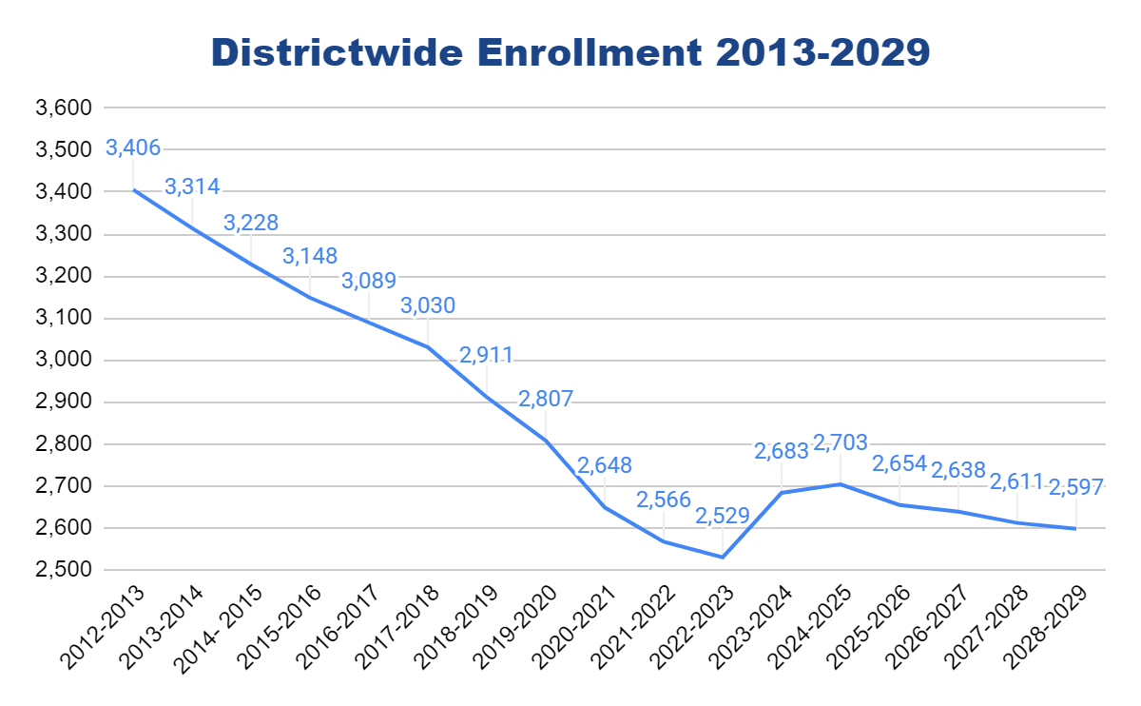
Districtwide
Year | Total Enrollment
2012-2013 | 3,406
2013-2014 | 3,314
2014- 2015 | 3,228
2015-2016 | 3,148
2016-2017 | 3,089
2017-2018 | 3,030
2018-2019 | 2,911
2019-2020 | 2,807
2020-2021 | 2,648
2021-2022 | 2,566
2022-2023 | 2,529
2023-2024 | 2,683
2024-2025 | 2,703
2025-2026 | 2,654
2026-2027 | 2,638
2027-2028 | 2,611
2028-2029 | 2,597
Preschool Implementation 1/1/23-6/30/25
}
Projected Change in Total Enrollment 2013 vs. 2029:
Decrease of 809 students or -23.8%
Highest District Enrollment on Record: 3,648 in October 2006
Notes:
The graph shows a bump in enrollment for the 23/24 and 24/25 school years. This relates to the implementation of the free General Education preschool program and assumes full implementation in the 24/25 school year.
S-2 Background - Prior to the implementation of S-2, the district’s funding was frozen at the saem level as 2010. Part of the stated purpose of S-2 was to phase out “overfunding” of districts that have experienced reductions in enrollment

Slide 7
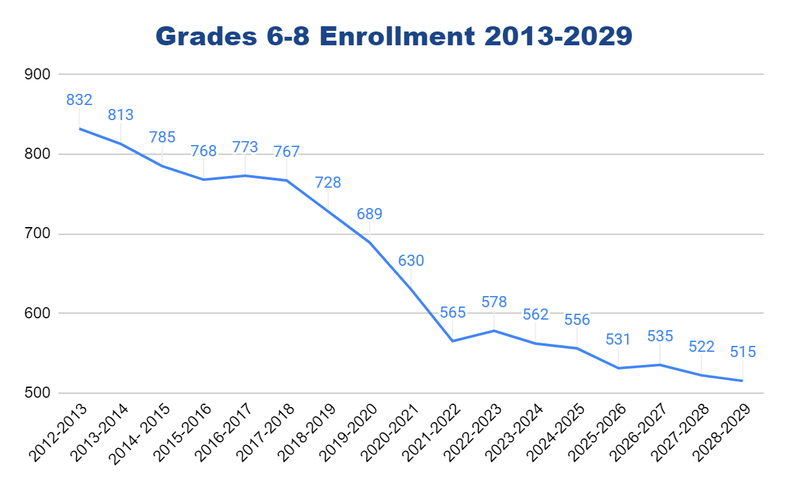
Grades 6-8
Year | Grades 6-8
2012-2013 | 832
2013-2014 | 813
2014- 2015 | 785
2015-2016 | 768
2016-2017 | 773
2017-2018 | 767
2018-2019 | 728
2019-2020 | 689
2020-2021 | 630
2021-2022 | 565
2022-2023 | 578
2023-2024 | 562
2024-2025 | 556
2025-2026 | 531
2026-2027 | 535
2027-2028 | 522
2028-2029 | 515
Projected Change in 6-8 Enrollment 2013 vs. 2029:
Decrease of 317 students or -38.1%
Highest Middle School (6-8) Enrollment on Record: 922 in October 2004
Notes:
Staff reductions have been taken over time to account for reduced enrollment, either through attrition or reduction in force
One Assistant Principal position was eliminated
Deteaming of 8th grade
For 24/25 - 556 in grades 6-8 and 177 in grade 5, if combined would be 733 which is similar to the number of students that attended the middle school in 18/19

Slide 8
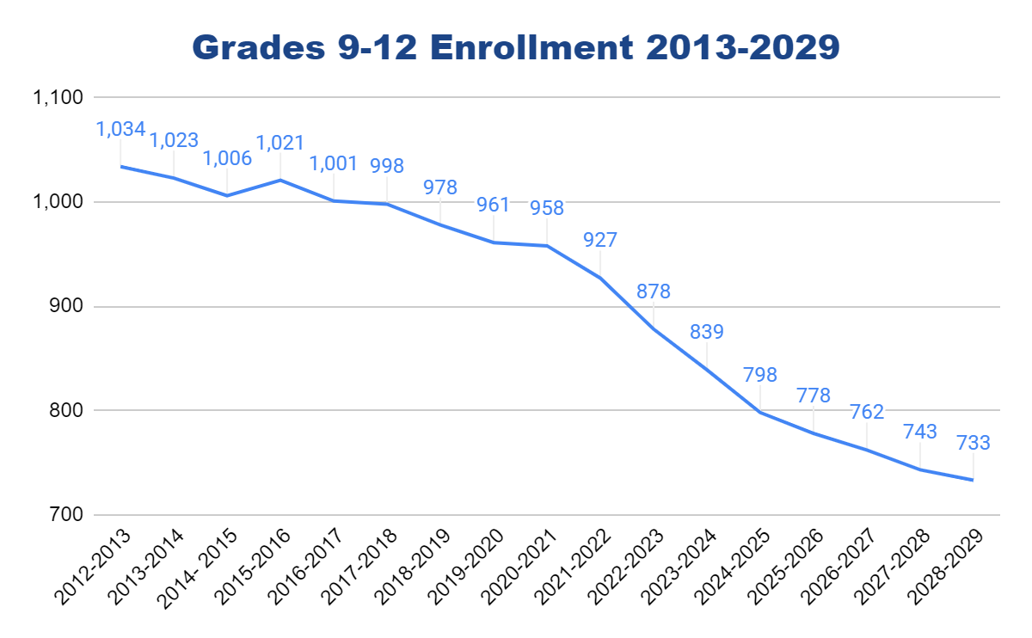
Grades 9-12
Year | Grades 9-12
2012-2013 | 1,034
2013-2014 | 1,023
2014- 2015 | 1,006
2015-2016 | 1,021
2016-2017 | 1,001
2017-2018 | 998
2018-2019 | 978
2019-2020 | 961
2020-2021 | 958
2021-2022 | 927
2022-2023 | 878
2023-2024 | 839
2024-2025 | 798
2025-2026 | 778
2026-2027 | 762
2027-2028 | 743
2028-2029 | 733
Projected Change in 9-12 Enrollment 2013 vs. 2029:
Decrease of 301 students or -29.1%
Highest High School (9-12) Enrollment on Record: 1,125 in October 2007
Notes:
Staff reductions have been taken over time to account for reduced enrollment, either through attrition or reduction in force
Electives are being reviewed to determine the frequency with which they will run
Over the implementation of S-2, extracurricular programs were reduced and then reimplemented in order to ensure that a variety of opportunities are available to students

Slide 9
Enrollment
Impacts of S-2 on yearly budget
Elementary enrollment decline mostly flattened long-term
Middle School enrollment continues to mildly decline
High School enrollment will begin to steeply decline

Slide 10
Parent Survey
Topics of concern brought to my attention:
Transportation
Aftercare
Recess
Self-contained vs switching classes
Special classes
Participation in co-curricular activities
Changing for PE
Elementary Events (Lose vs. Gain)
SEL Concerns
Certification
Timeframe
Parent-Teacher Conferences
Trimesters vs. Marking Periods

Slide 11
Review of Survey Data

Slide 12
Finalization of Recommendations

